Slide 1
TIME AND GLOBAL STATES

Slide 2
Introduction
Time is an important and interesting issue in distributed systems, for several reasons.
First, time is a quantity we often want to measure accurately.
In order to know at what time of day a particular event occurred at a particular computer it is necessary to synchronize its clock with an authoritative, external source of time.
Example:
eCommerce transaction involves events at a merchant’s computer and at a bank’s computer.
It is important, for auditing purposes, that those events are timestamped accurately.

Slide 3
Introduction
Second, algorithms that depend upon clock synchronization have been developed for several problems in distribution
Maintaining the consistency of distributed data
Checking the authenticity of a request sent to a server
Eliminating the processing of duplicate updates

Slide 4
Introduction
The notion of physical time is problematic in a distributed system.
Problem is based on a similar limitation in our ability to timestamp events at different nodes sufficiently accurately to know the order in which any pair of events occurred, or whether they occurred simultaneously.
There is no absolute, global time to which we can appeal.
Physical events order based on observer’s frame of reference
Sometimes we need to observe distributed systems and establish whether certain states of affairs occurred at the same time.
Establishing this requires observations of the
states of processes
communication channels between processes

Slide 5
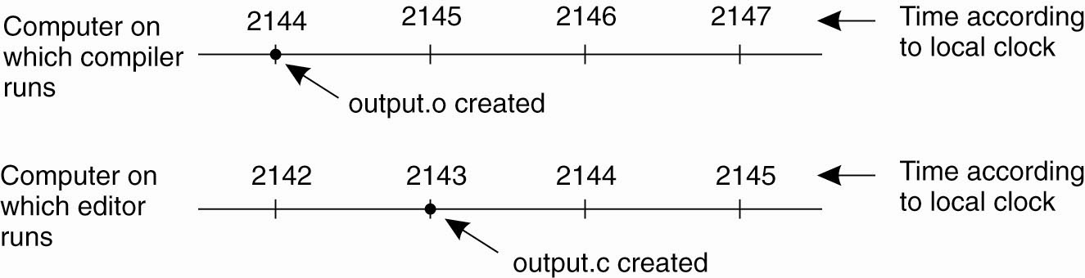
Introduction
@Pearson Education 2007

Slide 6
Clocks, Events, States
Interaction model
Distributed systems consist of collection of N processes p₁, p₂, …, p_{N}
Each process executes on a single processor
Each process has a state s_{i} which it transforms
Processes communicate by sending messages
Each process executes a series of actions: action is
Message Send operation
Message Receive operation
Operation that transforms p_{i}’s state
Event is occurrence of a single action that process carries out as executes
Sequence of events
e → e’ if event e occurs before e’ in p_{i}
History of process p_{i}:
History(p_{i}) = h_{i} = <e⁰_{i}, e¹_{i}, e²_{i}, …>

Slide 7
Clocks
How to timestamp events
Each computer owns physical clock
Counts oscillations occurring in a crystal at a definite frequency
Software clock C_{i}(t) = αH_{i}(t) + β
Approximate measure for real, physical time t for process p_{i}:
H_{i}(t) is hardware clock value
α is scale value
β is offset
I.e. could be 64-bit value of the number of nanoseconds that have elapsed at time t since a convenient reference time
Note that successive events will correspond to different timestamps only if clock resolution is smaller than the time interval between successive events

Slide 8
Clocks
Skew between clocks
Instantaneous difference between the readings of any two clocks
Clock drift
Crystal-based clocks count time at different rates and diverge
Physical variations, temperature may affect
Clock’s drift rate
Change in the offset between clock and nominal perfect reference clock
For ordinary clocks about 10⁻⁶ sec/sec, giving a difference of 1 second every 1 000 000 second
For ”high precision” clocks 10⁻⁷ to 10⁻⁸
@Addison-Wesley 2005

Slide 9
Clocks
Coordinated Universal Time (UTC)‏
Most accurate physical clocks use atomic oscillator
Drift rate about one part in 10¹³
Output is used as standard for elapsed time, International Atomic Time
International standard for timekeeping
Based on atomic time but leap second is inserted
Signals are synchronized and broadcast regularly from radio stations or satellites

Slide 10
How is TAI Measured?
International Atomic Time is an extraordinarily precise means of time-keeping.
Atomic clocks deviate only 1 second in up to 100 million years.
The secret to this impeccable precision is the correct measurement of the second as the base unit of modern time-keeping.
The International System of Units (SI) defines one second as the time it takes a Cesium-133 atom at the ground state to oscillate exactly 9,192,631,770 times.

Slide 11
International Atomic Time
International Atomic Time is a high-precision atomic coordinate time standard based on the notional passage of proper time on Earth's geoid.
It is the principal realisation of Terrestrial Time (with a fixed offset of epoch).
It is also the basis for Coordinated Universal Time (UTC), which is used for civil timekeeping all over the Earth's surface.
As of 31 December 2016, when another leap second was added
TAI is exactly 37 seconds ahead of UTC.
The 37 seconds results from the initial difference of 10 seconds at the start of 1972, plus 27 leap seconds in UTC since 1972.

Slide 12
Physical Clocks
Because of slowdown of earth, leap seconds have to be introduced
Correction of TAI is called Universal Coordinated Time (UTC): 30 leap seconds introduced so far
Network Time Protocol (NTP) can synchronize globally with an accuracy of up to 50 msec

Slide 13
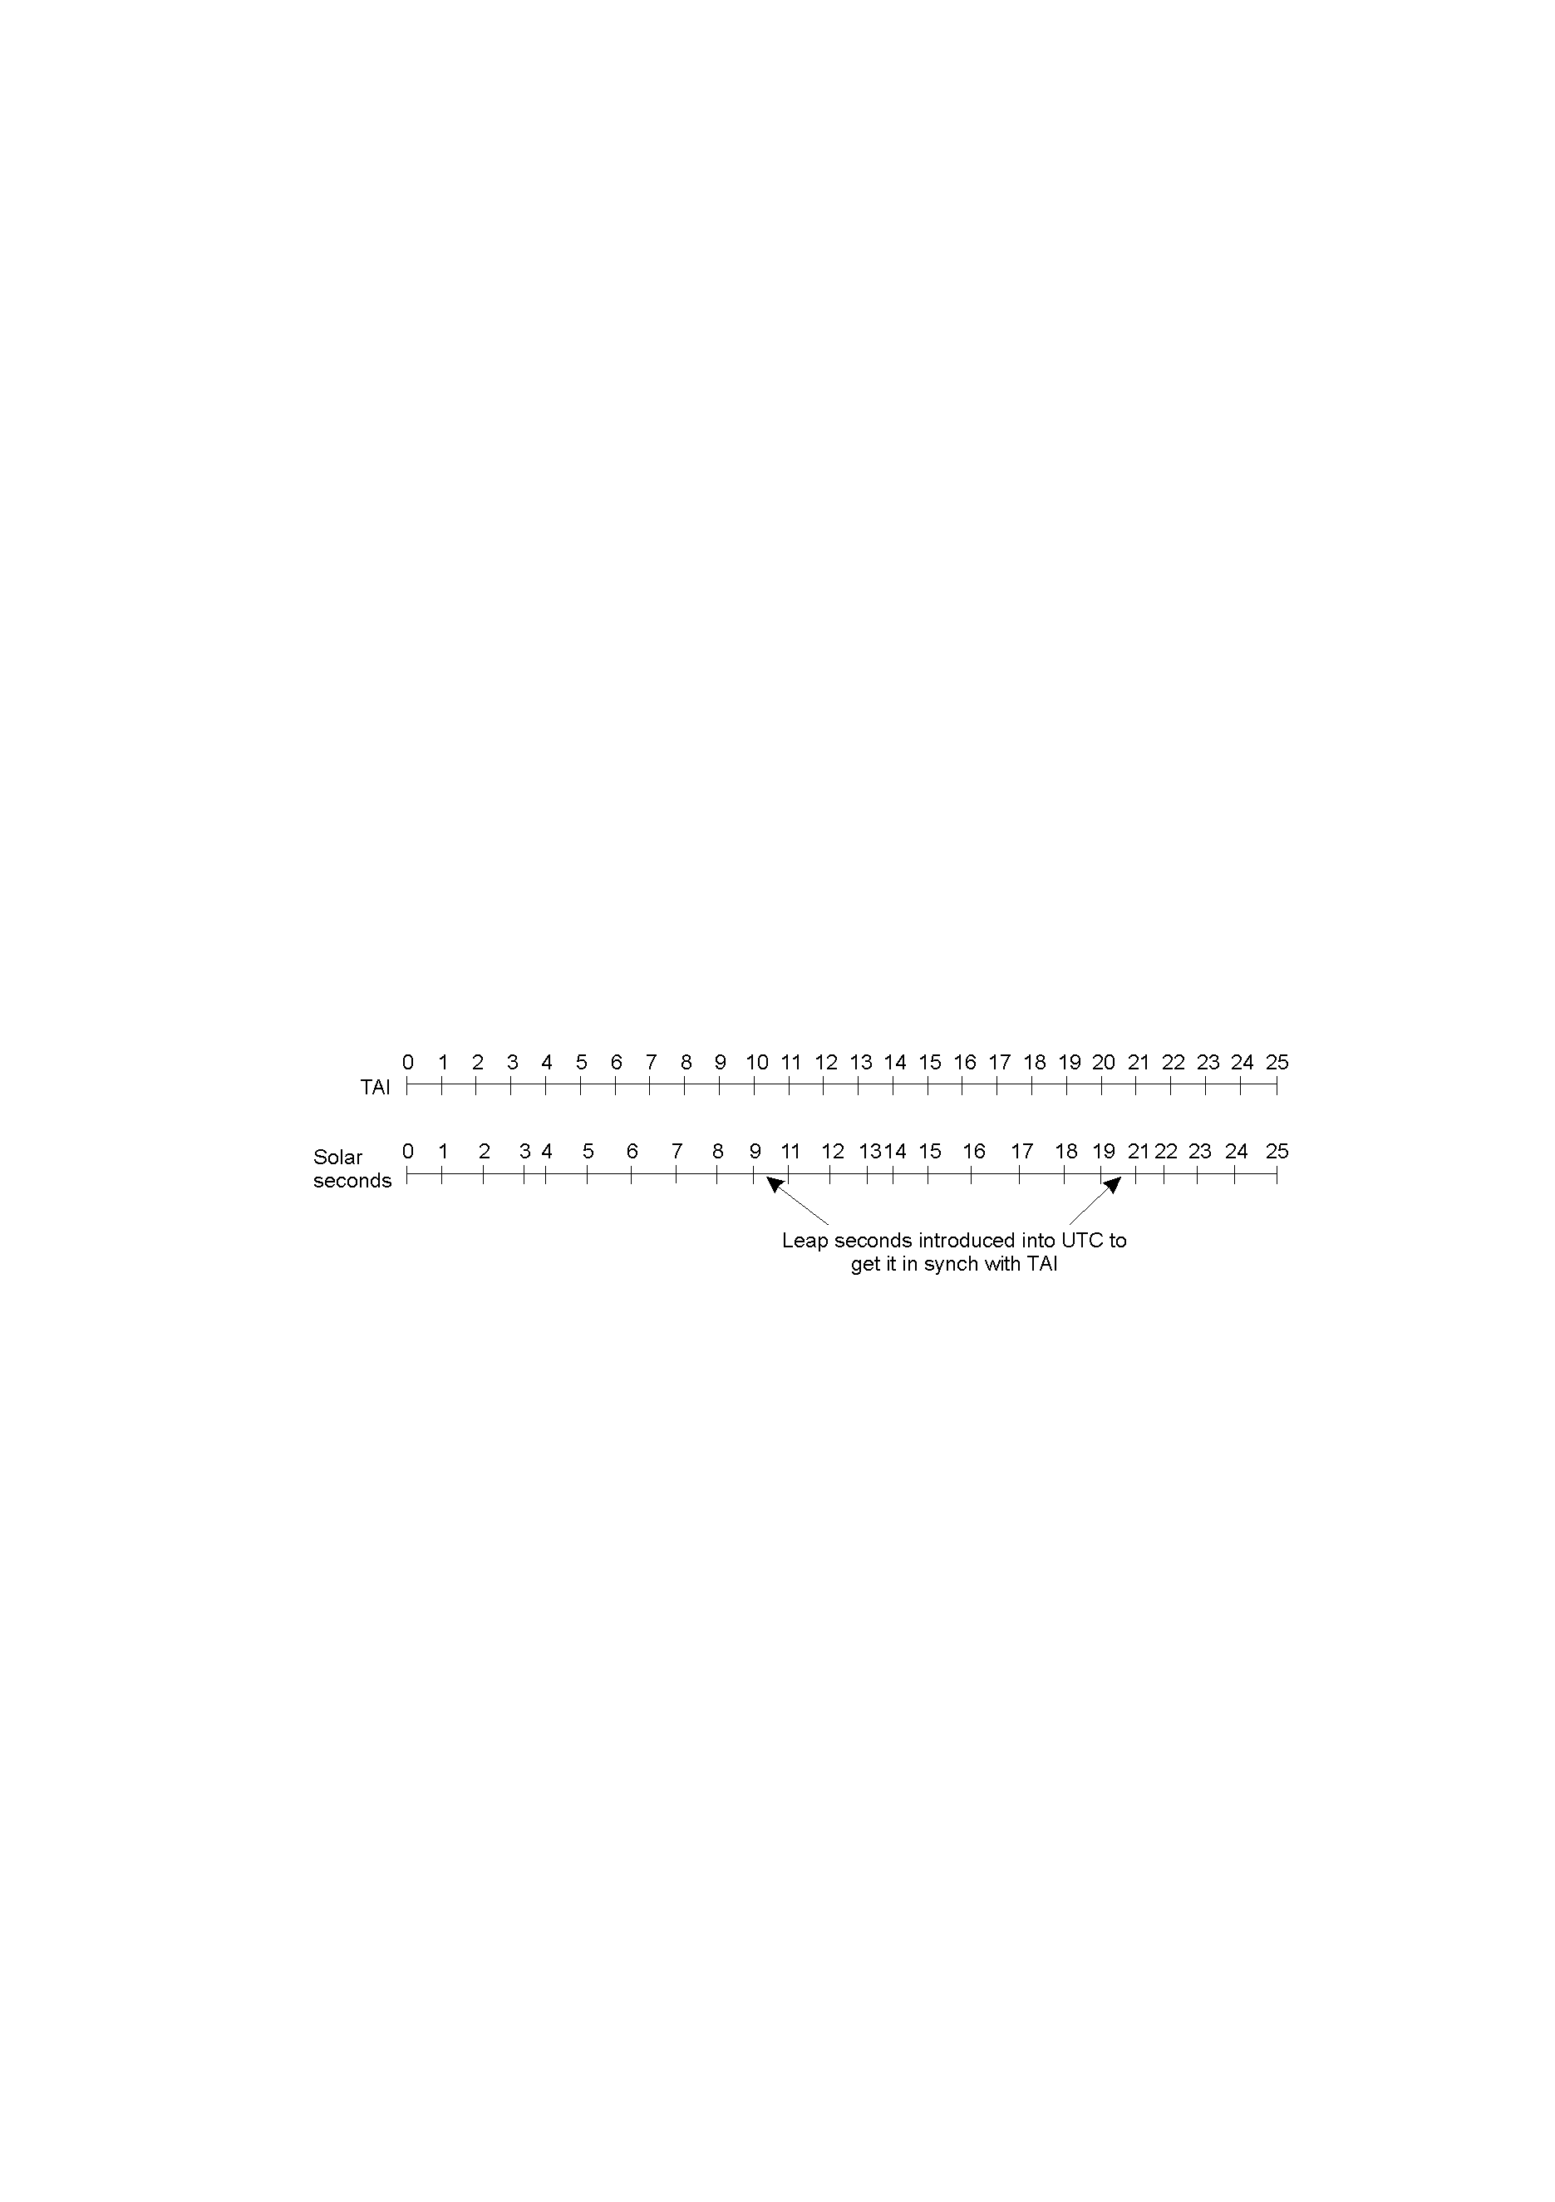
Physical Clocks
TAI seconds are of constant length, unlike solar seconds. Leap seconds are introduced when necessary to keep in phase with the sun.

Slide 14
Synchronizing Physical Clocks
External synchronization
Processes’ clocks C_{i} are synchronized with authoritative, external source of time
For a synchronization bound D > 0 and for source S of UTC time
|S(t) - C_{i}(t) | < D for i= 1,2,…,N and for all t
Clocks C_{i} are accurate within the bound D
Internal synchronization
Clocks are synchronized with each other to a known degree of accuracy
For a synchronization bound D > 0
|C_{i}(t) - C_{j}(t)| < D for i, j = 1, 2, …, N and for all t
Clocks C_{i} are agreed within the bound D
Clocks that are internally synchronized are not necessarily externally synchronized
If system is externally synchronized within bound D then the same system is internally synchronized with bound of 2D

Slide 15
Synchronizing Physical Clocks
Correctness for clocks
Hardware clock H is correct if its drift rate falls within a known bound ρ > 0
Error in measuring the interval between real times t and t’ (t’ > t) is bounded
(1- ρ)(t’-t) ≤ H(t’) - H(t) ≤ (1+ ρ)(t’-t)‏
Forbids jumps in the value of hardware clocks
Monotonicity
t’>t => C(t’) > C(t)‏
Hybrid correctness condition
Clock obeys monotonicity condition
Drift rate is bounded between synchronization points
Allow clock value to jump ahead at synchronization points

Slide 16
Synchronizing Physical Clocks
For example
UNIX make facility is a tool that is used to compile only those source files that have been modified since they were last compiled.
The modification dates of each corresponding pair of source and object files are compared to determine this condition.
If a computer whose clock was running fast set its clock back after compiling a source file but before the file was changed, the source file might appear to have been modified prior to the compilation.
Erroneously, make will not recompile the source file.

Slide 17
A clock that does not keep to whatever correctness conditions apply is defined to be faulty.
A clock’s crash failure is said to occur when the clock stops ticking altogether;
any other clock failure is an arbitrary failure.
A historical example of an arbitrary failure is that of a clock with the ‘Y2K bug’,
which broke the monotonicity condition by registering the date after 31 December 1999 as 1 January 1900 instead of 2000;
Another example is a clock whose batteries are very low and whose drift rate suddenly becomes very large.

Slide 18
Synchronization in Synchronous System
Internal synchonization between two processes
Bounds are known for
Drift rate of clocks
Maximum message transmission delay
Time to execute each step of process
One process sends time t on its local clock to other in a message
Receiver process sets its clock to time t + T_{trans}
T_{trans} is time taken to transmit m
Is subject to variation and is unknown
Minimum transmission time min can be measured or conservatively estimated: no other processes are executed or no other network traffic exist
Let uncertainty in message transmission time be u = max – min
If receiver sets its clock to t + (max + min)/2, then the skew is at most u/2
Optimum bound that can be achieved on clock skew when synchronizing N clocks is u(1 - 1/N)‏

Slide 19
Most distributed systems found in practice are asynchronous:
the factors leading to message delays are not bounded in their effect
there is no upper bound max on message transmission delays.
For an asynchronous system, we may say only that Ttrans = min + x , where x>= 0.
The value of x is not known in a particular case, although a distribution of values may be measurable for a particular installation.

Slide 20
Cristian’s method for synchronizing clocks
Time server, connected to a device receiving signals from UTC.
Upon request, the server S supplies the time t according to its clock.
The algorithm is probabilistic and can achieve synchronization only if the observed round trip time are short compared with required accuracy.
From p’s point of view, the earliest time S could place the time in mt was min after p dispatch mr. The latest was min before mt arrived at p.
m
r
m
t
p
Time server,S

Slide 21
Cristian’s Algorithm (Accuracy)
Assumption
Request & reply via same network
The value of minimum transmission time min is known or conservatively estimated.

Slide 22
Cristian’s Method
T_{round} should be in order of 1-10 milliseconds on LAN
Clock with drift rate of 10⁻⁶ sec/sec varies by at most 10⁻⁵ sec
Simple estimate of the time to which p should set its clock is t + T_{round} /2
Normally reasonable accurate assumption unless two messages are transmitted over different networks
If min is known or can be conservatively estimated, accuracy can be determined
Earliest point at which S could have placed the time in m_{t} was min after p dispached m_{r}
Latest point was min before m_{t} arrived at p
Time by S’s clock when reply message arrives is in range [ t + min, t + T_{round} – min]
Width of range is T_{round} - 2min
Accuracy is +/- (T_{round} /2 - min)‏

Slide 23
Cristian’s Method
Discussion
Problem associated with all services implemented by single server
A group of synchronized time servers
Client could multicast its request
Faulty time server replies with spurious time values
Imposter time server that replies with deliberately incorrect time
Suitable for deterministic LAN environment or Intranet

Slide 24
Berkeley Algorithm
For internal synchronization
Coordinator computer acts as master
Polls the other computers, called slaves, whose clocks are to be synchronized
Slaves send back their clock values
Master estimates their local clocks by observing round-trip times and averages the values
Average cancels out individual clock’s tendencies to run fast or slow
Master sends to slaves amount by which each individual slave’s clock requires adjustment
Eliminates readings from faulty clocks
Master takes a fault-tolerant average
Experiment involving 15 computers
Whose clocks were synchronized to within about 20-25 msec
Local clock’s drift rate less than 2x10⁻⁵
Maximum round-trip time 10 msec
If master fails, another can be elected to take over and function

Slide 25
Berkeley Algorithm
The Berkeley algorithm eliminates readings from faulty clocks.
Such clocks could have a significant adverse effect if an ordinary average was taken
so master takes a fault-tolerant average.
Subset is chosen of clocks that do not differ from one another by more than a specified amount,
average is taken of readings from only these clocks.

Slide 26
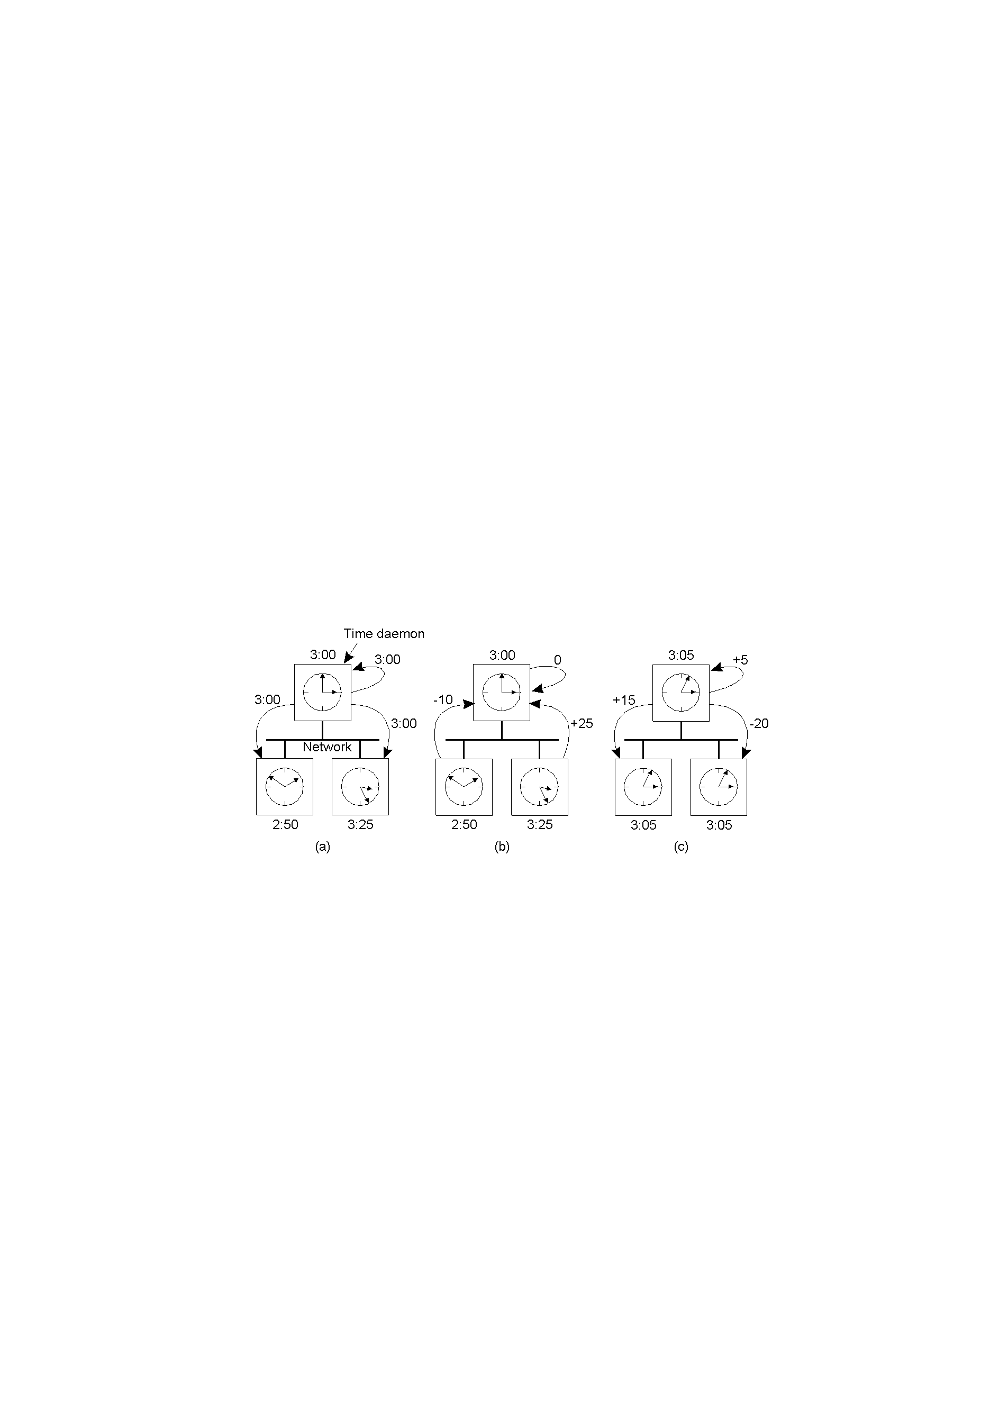
Berkeley Algorithm
@Pearson Education 2007

Slide 27
Network Time Protocol (NTP)
Cristian’s method and the Berkeley algorithm are intended primarily for use within intranets.
The Network Time Protocol (NTP) [Mills 1995] defines an architecture for a time service and a protocol to distribute time information over the Internet.

Slide 28
NTP’s chief design aims and features
NTP’s chief design aims and features are as follows
To provide a service enabling clients across the Internet to be synchronized accurately to UTC:
Although large and variable message delays are encountered in Internet communication,
NTP employs statistical techniques for the filtering of timing data
it discriminates between the quality of timing data from different servers.
To provide a reliable service that can survive lengthy losses of connectivity:
There are redundant servers and redundant paths between the servers.
The servers can reconfigure so as to continue to provide the service if one of them becomes unreachable.

Slide 29
NTP’s chief design aims and features
To enable clients to resynchronize sufficiently frequently to offset the rates of drift found in most computers:
The service is designed to scale to large numbers of clients and servers.
To provide protection against interference with the time service, whether malicious or accidental:
The time service uses authentication techniques to check that timing data originate from the claimed trusted sources.
It also validates the return addresses of messages sent to it.

Slide 30
Network Time Protocol
Protocol to distribute time information over the Internet
Service is provided by a network of servers across the Internet
Primary servers and secondary servers
Primary servers are connected directly to a time source such as a radio clock receiving UTC
secondary servers are synchronized, ultimately, with primary servers
Forms hierarchy called synchronization subnet; levels are strata
Lowest-level servers execute in users’ workstations
If a strata 1 server fails, it may become a stratum 2 secondary server

Slide 31
The Network Time Protocol (NTP)
Uses a network of time servers to synchronize all processes on a network.
Time servers are connected by a synchronization subnet tree. The root is in touch with UTC. Each node synchronizes its
children nodes.
Primary server, direct synch.
1
Secondary servers, synched by the primary server
2
2
2
Strata 3, synched by the secondary servers
3
3
3
3
3
3
Notes:
Main adv: f-t of av. and accuracy.
Synch: multicast mode or procedure call mode (~Cristian’s algorithm) or symmetric mode (next slide)

Slide 32
Network Time Protocol
The clocks belonging to servers with high stratum numbers are liable to be less accurate than those with low stratum numbers,
Because errors are introduced at each level of synchronization.
NTP also takes into account the total message round-trip delays to the root in assessing the quality of timekeeping data held by a particular server.
The synchronization subnet can reconfigure as servers become unreachable or failures occur.
If, for example, a primary server’s UTC source fails, then it can become a stratum 2 secondary server.
If a secondary server’s normal source of synchronization fails or becomes unreachable, then it may synchronize with another server.

Slide 33
Network Time Protocol
Servers synchronize with one other in one of three modes:
Multicast
For use on a high-speed LAN
Server periodically multicast the time to other servers
They set their clocks assuming a small delay
Procedure-call
Similar to operation of Christian’s algorithm
Server accepts requests from other computers and replies with timestamp
Suitable where higher accuracies are required or where multicast is not supported in hardware
Symmetric
For servers that supply time information in LANs and by higher levels of synchronization subnet
Where highest accuracies are needed
A pair of servers operating in symmetric mode exchange messages bearing timing information
Messages are delivered using UDP protocol

Slide 34
Network Time Protocol
In procedure-call mode and symmetric mode, processes exchange pairs of messages.
Each message bears
timestamps of recent message events:
local times when the previous NTP message between the pair was sent and received,
local time when the current message was transmitted.
The recipient of the NTP message notes the local time when it receives the message.

Slide 36
Network Time Protocol
For each pair of messages sent between two servers the NTP calculates
Offset o_{i}: an estimate for the actual offset between two clocks
Delay d_{i}: the total transmission time for two messages
If the true offset of the clock at B relative to that at A is o and actual transmission times for m and m’ are t and t’ respectively
Delay:
T_{i-2} = T_{i-3} + t + o and T_{i} = T_{i-1} + t’ – o leads to
d_{i} = t + t’ = T_{i-2} - T_{i-3} + T_{i} - T_{i-1}
Offset
o = o_{i} + (t’ - t)/2, where o_{i} = (T_{i-2} - T_{i-3} + T_{i-1} - T_{i})/2
Using t, t’ ≥ 0 it can be shown that o_{i} - d_{i}/2 ≤ o ≤ o_{i} + d_{i}/2
o_{i} is an estimate for o, and d_{i} is a measure of the accuracy of estimate

Slide 37
Theoretical Base for NTP
Server B
T
T
i
-2
i-1
Time
m
m'
Time
Server A
T
T
i
-
3
i
t and t’: actual transmission times
for m and m’(unknown)
o: true offset of clock at B
relative to clock at A
o_{i}: estimate of actual offset
between the two clocks
d_{i}: estimate of accuracy of o_{i} ;
total transmission times for m
and m’; d_{i}=t+t’

Slide 38
Network Time Protocol
Servers apply a data filtering algorithm to successive pairs <o_{i}, d_{i}>
The value of o_{i} that corresponds to the minimum value d_{i} is chosen to estimate o
NTP server engages in message exchanges with several peers and applies a peer-selection algorithm
Peer with unreliable values may be changed
Peers with lower stratum are more favoured than those in higher strata
NTP employs a phase lock loop model
Modifies the local clock’s update frequency in accordance with observations of its drift rate
Synchronization accuracies in order of tens of msecs over Internet and 1 msec on LAN

Slide 39
Is it enough to synchronize physical clocks?
Value received from UTC receiver is only accurate to within 0.1–10 milliseconds
At best, we can synchronize clocks to within 10–30 milliseconds of each other
We have to synchronize frequently, to avoid local clock drift

Slide 40
Is it enough to synchronize physical clocks?
In 10 ms, a 100 MIPS machine can execute 1 million instructions
Accurate enough as time-of-day
Not sufficiently accurate to determine the relative order of events on different computers in a distributed system

Slide 41
Logical time and clocks
Can't synchronize physical clocks perfectly
Absolute time might not be necessary, just need ordering of events
Logical clocks: Lamport, 1978
Happened-before relationship among events
Potential causal ordering

Slide 42
What are Logical Clocks ?
A logical clock is a mechanism for capturing chronological sequence and causal relationships of events in a distributed system.
Clock Implementation
Data structure
Clock Update Protocol
Logical clock algorithms of note are:
Scalar clocks
Vector clocks
Matrix clocks

Slide 43
Happen-before relation
e -> e'
two events occur in the same process
a message is sent between two processes
Happened-before relation:
HB1: if e -> e' in process i, then e -> e'
HB2: for any message m, send(m) -> receive(m)
HB3: if e -> e' and e' -> e'', then e -> e''

Slide 44
Happened-Before Relationship →
HB1: There exists a process and two events e1 and e2 that occurred in that order then, e1→e2
HB2: For any message m, send(m) → receive (m)
HB3: if there are events e1, e2, e3, e1→e2, e2→e3, then e1→e3

Slide 45
Events occurring at three processes

Slide 46
Happen-before vs. causality
e || e' if the two events aren't in a particular order (concurrent)‏
potential causality: e -> e’ doesn't mean that e causes e'
naturally, if e causes e’, e -> e’

Slide 47
Logical Clocks (1/2)‏

Slide 48
Logical Clocks (2/2)‏

Slide 49
Logical clocks (LC)
Lamport designed a simple mechanism by which HB ordering can be captured numerically, called logical clock.
A logical clock is monotonically increasing software counter, with no relationship to physical clock.
Rules for logical clocks:
LC1: Li is incremented before each event in Pi
LC2:
When a process Pi sends a message m, it piggy backs on m t = Li
On receiving the message process Pj computes Lj = max(Lj, t), applies LC1, and timestamps receive message event.

Slide 50
Figure 11.5 Events occurring at three processes

Slide 51
Figure 11.6 Lamport timestamps for the events shown in Figure 11.5

Slide 52
One more example LC2: Lamport timestamps for the events shown in Figure 11.5
2
3
4
5
?

Slide 53
Total Ordering with Logical Clocks

Slide 54
Events occurring at three processes
1
2
p
1
a
b
m
1
3
4
p
Physical
2
c
d
time
m
2
1
5
p
3
e
f
Limitations of Lamport Clocks:
It represents a partial order, if a → b it implies that L(a) < L(b) but the converse is not true, i.e., if L(a) < L(b) it doesn’t imply a → b. From the fig. L(b) > L(e) but in fact, b||e.

Slide 55
Vector clocks
Lamport clocks: C(e) < C(e') doesn't imply e -> e'
each process keeps its own vector clock V_{i}
piggyback timestamps on messages

Slide 56
Vector Clocks (Mattern ’89 & Fidge ’91)
To overcome the problems of Lamport Clock ➔ Vector clocks
A vector clock for a system of N processes is an array of N integers. P_{i} keeps its VC V_{i}, to timestamp local events.
Vector clock rules:
VC1: Initially for each process p_{i}, V_{i}[j] = 0,
for j = 1,2, …, N
VC2: Just before time stamping an event, p_{i} sets
V_{i}[i] = V_{i}[i]+ 1.
VC3: p_{i} sends t = V_{i} in every message it sends
VC4: When p_{i} receives t in a message, it sets
V_{i}[j] = max(V_{i}[j], t[j]), for j = 1,2, …, N
(the max is computed component wise)

Slide 57
Vector timestamps (Fig 11.7)‏

Slide 58
Vector clocks
At p_{i}
V_{i}[i] is the number of events p_{i} timestamped locally
V_{i}[j] is the number of events that have occurred at p_{j} (that has potentially affected p_{i} )‏
Could more events than V_{i}[j] have occurred at p_{j}?

Slide 59
Example: Vector Timestamps
Physical Time
p 1
1,0,0,0
2,0,0,0
4,0,2,2
0,0,0,0
3,0,2,2
(1,0,0,0)
p 2
1,2,0,0
(4,0,2,2)
0,0,0,0
1,1,0,0
(2,0,0,0)
(1,2,0,0)
(2,0,2,2)
p 3
0,0,0,0
2,0,2,0
2,0,1,0
2,2,3,0
4,2,4,2
4,2,5,3
(2,0,2,0)
(2,0,2,3)
p 4
0,0,0,0
2,0,2,2
2,0,2,1
2,0,2,3
n,m,p,q
Vector logical clock
(vector timestamp)
Message

Slide 60
Comparing Vector Timestamps
VT₁ = VT₂,
iff VT₁[i] = VT₂[i], for all i = 1, … , n
VT₁ < VT₂,
iff VT₁[i] < VT₂[i], for all i = 1, … , n
VT₁ < VT₂,
iff VT₁ < VT₂ &
∃ j (1 < j < n & VT₁[j] < VT₂ [j])
Then: VT₁ is concurrent with VT₂
iff (not VT₁ < VT₂ AND not VT₂ < VT₁)

Slide 61
Vector timestamps
if e -> e', then V(e) < V(e')‏
if V(e) < V(e'), then e -> e'.
Figure 11.7
neither V(c) <= V(e) nor V(c) >= V(e)‏
c || e
Disadvantage compared to Lamport timestamps?

Slide 62
Vector timestamps `-disadvantage
Amount of storage and message payload that is proportional to N, the number of processes.
Charron-Bost [1991] showed that, if we are to be able to tell whether or not two events are concurrent by inspecting their timestamps, then the dimension N is unavoidable.
However, techniques exist for storing and transmitting smaller amounts of data, at the expense of the processing required to reconstruct complete vectors.

Slide 63
Detecting global properties
We want to find out whether a particular property is true of a distributed system as it executes.
We will see three examples:
Distributed garbage collection: if there are no longer any reference to objects anywhere in the distributed system, the memory taken up by the objects should be reclaimed.
Distributed deadlock detection: when each of a collection of processes waits for another process to send it a message, and where there is a cycle in the graph of this “wait-for” relationship.
Distributed termination detection: detect if a distributed algorithm has terminated. It seems that we only need to test whether each process has halted. However, it is not true.
.
E.g. two processes and each of which may request values from the other. It can be either in passive or active state. Passive means it is not engaged in any activity but is prepared to respond. Two processes may both in passive states. At the same time, there is a message in on the way from P2 to P1, after P1 receives it, it will become active again. So the algorithm has not terminated

Slide 64
Global States
Detecting global properties
@Addison-Wesley 2005

Slide 65
Global States and consistent cuts
It is possible to observe the succession of states of an individual process, but the question of how to ascertain a global state of the system – the state of the collection of processes is much harder.
The essential problem is the absence of global time. If we had perfectly synchronized clocks at which processes would record its state, we can assemble the global state of the system from local states of all processes at the same time.
The question is: can we assemble the global state of the system from local states recorded at different real times?
The answer is “YES”.

Slide 66
Some definitions
A series of events occurs at each process. Each event is either an internal action of the process (variables updates) or it is the sending or receipt of a message over the channel.
is the state of process Pi before kth event occurs, so is the initial state of Pi.
Thus the global state corresponds to initial prefixes of the individual process histories.

Slide 67
Figure 11.9 Cuts
e
0
e
1
e
2
e
3
1
1
1
1
p
1
m
1
m
2
p
Physical
2
time
e
0
e
1
e
2
2
2
2
Inconsistent cut
Consistent cut
A cut of the system’s execution is a subset of its global history that is a union of prefixes of process histories.
The state of each process is in the state after the last event occurs in its own cut. The set of last events from all processes are called frontier of the cut.

Slide 68
Cuts
e
0
e
1
e
2
e
3
1
1
1
1
p
1
m
1
m
2
p
Physical
2
time
e
0
e
1
e
2
2
2
2
Inconsistent cut
Consistent cut
Inconsistent cut: since P2 contains receiving of m1, but at P1 it does not include sending of that message. This cut shows the an effect without a cause. We will never reach a global state that corresponds to process state at the frontier by actual execution under this cut.
Consistent cut: it includes both the sending and receipt of m1. It includes the sending but not the receipt of m2. It is still consistent with actual execution.

Slide 69
Consistent cut
A cut C is consistent if, for each event it contains, it also contains all the events that happened-before that event.
A consistent global state is one that corresponds to a consistent cut.
A run is a total ordering of all the events in a global history that is consistent with each local history’s ordering.
A linearization or consistent run is an ordering of the events in a global history that is consistent with this happened-before relation.

Slide 70
Global state predicate
Global state predicate is a function that maps from the set of global states of processes n the system to true or false.
Stable characteristics associated with object being garbage, deadlocked or terminated: once the system enters a state in which the predicate is True. It remains True in all future states reachable from that state.
Safety (evaluates to deadlocked false for all states reachable from S0)
Liveness ( evaluate to reaching termination true for some of the states reachable from S0)

Slide 71
Chandy and Lamport’s ‘snapshot’ algorithm
Chandy and Lamport(1985) describe a “snapshot” algorithm for determining global states of distributed system.
Record a set of process and channel states for a set of processes Pi such that even though the combination of recorded states may never have occurred at the same time, the recorded global state is consistent.
The algorithm records state locally at processes without giving a method for gathering the global state.

Slide 72
Assumption of Snapshot Algorithm
Neither channels nor processes fail; communication is reliable so that every message sent is eventually received intact, exactly once;
Channel are unidirectional either incoming or outgoing and provide FIFO order message delivery;
The graph of processes and channels is strongly connected (there is a path between any two processes).
Any process may initiate a global snapshot at any time.
The processes may continue their normal execution and send and receive normal massages while the snapshot takes place.

Slide 73
Snapshots Ideas
Each process records its own state and also for each incoming channel a set of messages sent to it.
Allow us to record process states at different times but to account for the differential between process states in terms of message transmitted but not yet received.
If process pi has sent a message m to process pj, but pj has not received it, then we account for m as belong to the state of the channel between them.

Slide 74
Chandy-Lamport Algorithm
Idea
Each process records its state and also for each incoming channel a set of messages sent to it
Process records for each channel any messages that arrived after it recorded its state and before the sender recorded its state
Use of marker messages
Prompt for receiver to save its own state
Means of determining which messages to include in the channel state
Two rules
Marker sending rule
Obligates processes to send a marker after they have recorded their state
Before they send any other messages
Marker receiving rule
If process has not recorded its state (this is the first received marker)‏
Obligates process to record its state
If process has already saved its state
Records state of that channel as the set of messages it received on since it saved its state

Slide 75
Figure 11.10 Chandy and Lamport’s ‘snapshot’ algorithm
Use of special marker message. It has a dual role, as a prompt for the receiver to save its own state if it has not done so; and as a means of determining which messages to include in the channel state.
******************************************************************
Marker receiving rule for process p_{i}
On p_{i}’s receipt of a marker message over channel c:
if (p_{i} has not yet recorded its state) it
records its process state now;
records the state of c as the empty set;
turns on recording of messages arriving over other incoming channels;
else
p_{i} records the state of c as the set of messages it has received over c
since it saved its state.
end if
Marker sending rule for process p_{i}
After p_{i} has recorded its state, for each outgoing channel c:
p_{i} sends one marker message over c
(before it sends any other message over c).

Slide 76
Figure 11.11 Two processes and their initial states
Two processes connected by two unidirectional channels, c1 and c2. The two processes trade in ‘widgets’. Process p1 sends orders for widgets over c2 to p2, enclosing payment at the rate of $10 per widget. Some time later, process p2 sends widgets along channel c1 to p1.
Process p2 already received an order for five widgets, which it will shortly dispatch to p1.

Slide 77
Figure 11.12 The execution of the processes in Figure 11.11
Final recorded state is:
P1<$1000,0>
P2<$50,1995>
C1<five widgets>
C2<>
1. P1 records its state in S0. Following the marker sending rule, it will send a marker over c2 to p2 before it sends the next order (10, $100). 2. Before p2 receives the marker, it sends five widgets to p1 over c1. 3. Now P1 receives five widgets and P2 receives marker. P2 will record it state S2 and record c2 as empty. Following the sending rule, p2 sends a marker to p1. 4. P1 receives the marker, P1 records the state of c1 as five widget that it received after it first recorded its state.

Slide 78
Chandy-Lamport Algorithm
Termination:
Assumed that a process that has received a marker message records its state within a finite time and sends marker messages over each outgoing channel within finite time
If there is a path of communication channels and processes from p_{i} to p_{j}, then p_{j} will record its state a finite time after p_{i} recorded its state
Since the communication graph is strongly connected, all processes will have recorded their state and the states of incoming channels a finite time after some process initially records its state

Slide 79
Chandy-Lamport Algorithm
Cut and recorded state is consistent
Let e_{i} and e_{j} be events occuring at p_{i} and p_{j}, and let e_{i} → e_{j}
If e_{j} is in the cut, then e_{i} is in the cut.
That is, if e_{j} occurred before p_{j} recorded its state, then e_{i} must have occurred before p_{i} recorded its state
j=i: obvious.
j≠i:
Assume p_{i} recorded its state before e_{j} occurred
Consider the sequence of H messages m₁, m₂, .., m_{H} giving rise to relation e_{i} → e_{j}
Marker message would have received p_{j} ahead of each of m₁, ..., m_{H} and p_{j} would have recorded its state before event e_{j} -> contradicts assumption

Slide 80
Chandy-Lamport Global Snapshot Algorithm (3)
The algorithm terminates when
All processes have received a Marker
To record their own state
All processes have received a Marker on all the (N-1) incoming channels at each
To record the state of all channels
Then, (if needed), a central server collects all these partial state pieces to obtain the full global snapshot

Slide 81
Summary
Clocks
Hardware clock value is scaled, and offset is added to it
Clock skew is difference in time values
Clock drift: clocks count time at different rates
UTC is international standard for timekeeping
Synchronizing physical clocks
Christian’s method uses time server
Berkeley algorithm: master computer polls the other computers and collects slaves’ clock values
Network Time Protocol: architecture over Internet
Different levels of servers
Lamport’s clocks
Happened-before relation is captured in logical clocks
Vector clocks are an improvement on Lamport clocks
Each process has own vector clock to timestamp local events
Timestamps are piggybacked in message
We can tell whether two events are ordered by happened-before or are concurrent by comparing their vector timestamps
Global states
Snapshot algorithm

